Slide 1
Performance of somatic mutations in the classification of endometrial carcinomas with CpG island methylator phenotype
Jonathan Feige
Notes:
There is a lot going on in this title so I will break it down
First is somatic mutations this is a mutation that can occur in any part of the body excluding gametes
The mutations can be insertions, deletions, frame shifts, or point changes
Next is classifications, these are preformed by classification models, the goal of a classification model is to take an unknown sample, and try to predict the classification of the sample
Endometrial carcinomas is a type of cancer that occurs in the uterus,
Lastly cpg island meth phenotype or CIMP which I will explain in a later slide

Slide 2
Introduction
Endometrial carcinoma is the 4th most common cancer in women in the US, with approximately 66,000 cases per year.
Individuals with endometrial carcinoma have ~30% fatality rate.
Individuals that are CpG island Methylator Phenotype positive (CIMP+) tend to tend to be non-responsive to chemotherapies in late-stage tumors compared to those who are CIMP-.
Notes:
So what is the problem we are trying to address?
EC is very hard to detect without very specific testing for EC
Therefor induvial that are CIMP+ are at much higher risk of their cancer becoming more sever very quickly

Slide 3
The Cancer Genome Atlas Program (The cancer genome atlas program. National Cancer Institute. (n.d.))
The Cancer Genome Atlas (TCGA)
TCGA was a joint effort between National Cancer Institute and the National Human Genome Research Institute that began in 2006.
Molecularly characterized over 20,000 primary cancer and matched normal samples
These span across 33 unique cancer types Including:
Endometrial Carcinoma
Gastric Carcinoma
Colorectal Carcinoma

Slide 4
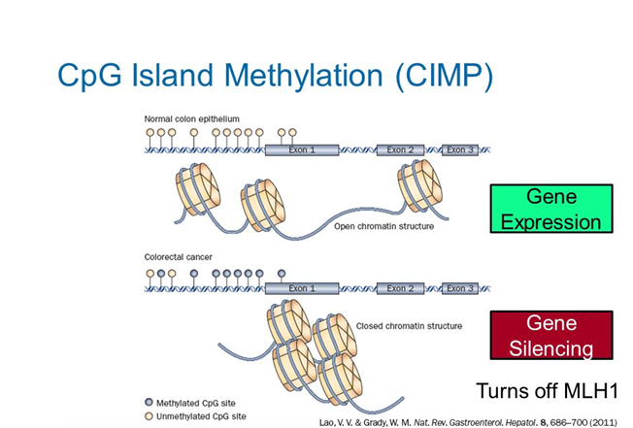
What is CIMP? (Sánchez-Vega et. al, 2015)
CIMP (CpG Island Methylator Phenotype).
CIMP is represented in three classes CIMP+, CIMP-, and CIMPi
If there is hypermethylation across the genome it is denoted as CIMP+.
Individuals who are CIMP+ tend to be non-responsive to chemotherapies in late-stage tumors.
Understanding CIMP gives insights into the biology of cancer.
Notes:
An exon is an area in the DNA that codes an amino acid, the amino acids make vital proteins
As you can see in the normal functioning genome there is not methylated groups in yellow, and the DNA can unravel and be read
For individuals with CIMP methylation occurs causing exons that were easily read to be tightly coiled and now unable to be read
When large amounts of methylation in blue occur before an exon the expression is no longer made, and the gene gets silenced.
MLH1 is a critical DNA repair gene, meaning now your cancer cell has no way to potentially fix itself and will continue to have bad mutations
Many tumor suppressor genes are affected by CIMP

Slide 5
Hypothesis and Aims
We hypothesize that by using just mutation data we can accurately classify CIMP status.
Aim 1 – Find the important mutations relating to CIMP.
Aim 2 – Find the relationships between the important mutations.
Aim 3 - Interpret the findings, biologically and medically.
Significance:
Individuals with CIMP+ are non-responsive to chemotherapies in late-stage tumors. Understanding the mutations that co-occur with CIMP can help lead to early diagnostics and treatments.
Understanding how the CIMP subtype is related to mutations, which may lead to new treatment techniques.
Notes:
Slow down
Exapnd
It is possible to identify unknown CIMP samples using just mutations.

Slide 6
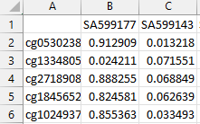
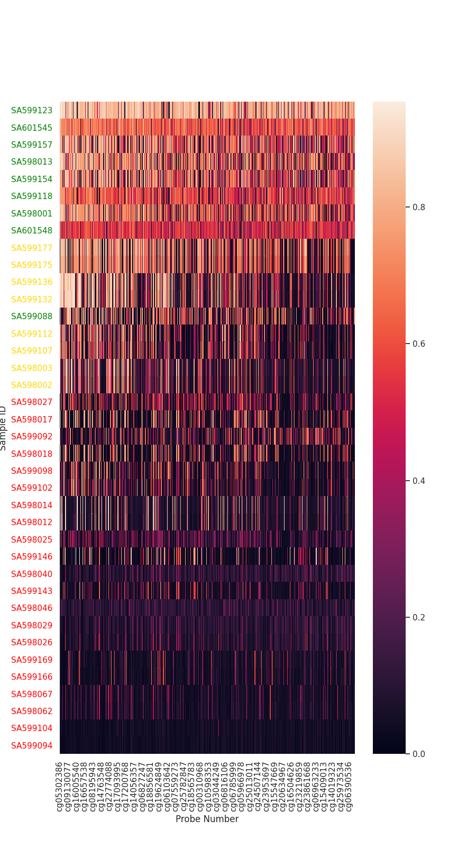
Classification of CIMP (Sánchez-Vega et. al, 2015)
Each sample from TCGA has a collection of methylation probes marked across the genome.
In endometrial carcinoma there are 1430 probes that measure methylation across each cancer sample.
Using K-Means Clustering (K=3) samples get grouped by methylation across the genome.
The samples with the highest methylation are CIMP+
The samples with the lowest methylation are CIMP-
Notes:
Methylation probes are locations in the genome, they read methylation
Typically used Illumina Methylation Assay
Draw boxes around each cluster

Slide 7
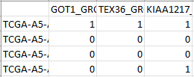
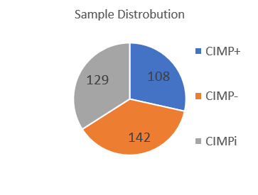
Data Collection
The data set used was collected from TCGA and consists of 379 unique samples.
Each sample in TCGA has been given a CIMP+ / CIMP- / CIMPi classification.
Across the X axis are a collection of 8085 unique mutations.
Across the Y axis are the sample ID’s.
Each cell contains a 1 or 0. If 1 then the mutation X occurs in the sample Y.
Notes:
The cancer genome atlas
Just like MLH1
Each sample was given their CIMP stats based on a collection of probes across the genome.
These probes measured methylation at specific locations. If there are high measures of methylation
The measurements are then used in a K-mean clustering where K is three (representing CIMP+, CIMPi, and CIMP-)
The cluster with the highest average methylation is CIMP+, lowest is CIMP- and middle is CIMPi
The intermediate samples are removed so there is a clear division between CIMP+ and CIMP-
With the removal there are 250 samples remaining

Slide 8
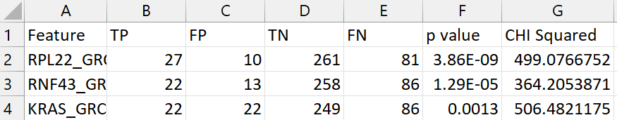
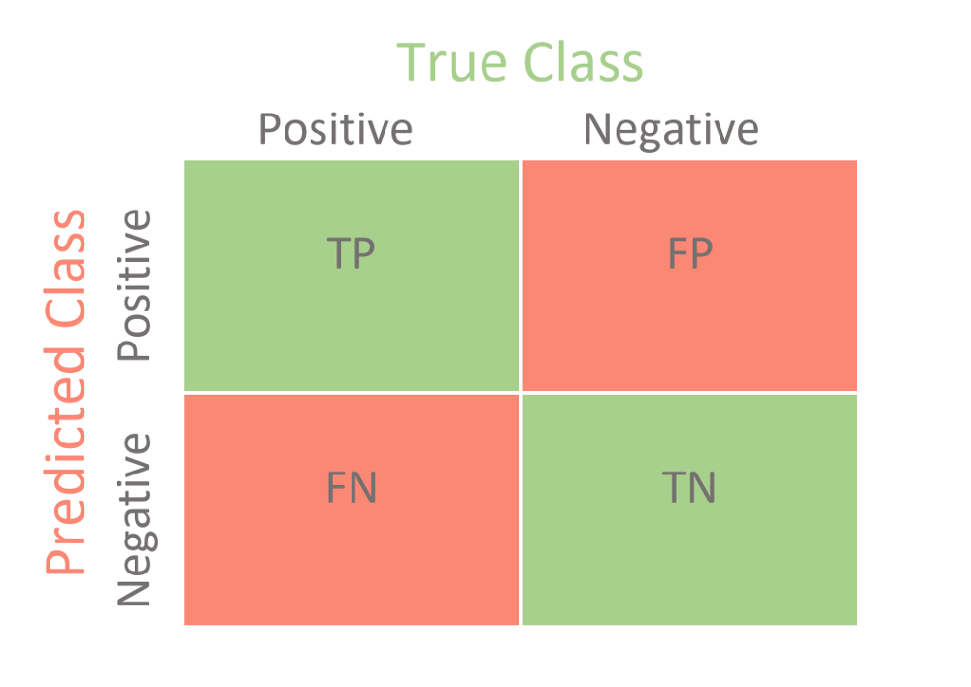
Mutational Selectors
Mutational selectors characterize a collection of mutations based on each statistical measure.
FP <= 0, 1, and 2.
TP>X and FP = 0 (TPX_FP0) where X is 3, 4 or 5.
Fishers exact p-value < 0.05, 0.01, and 0.005
Chi squared > 3.84, 7.68, 15.36
Using all mutations (Included as a baseline 8085 mutations)
TP denotes a mutation occurring in a CIMP+ sample (Foreground).
FP denotes a mutation occurring in a Non-CIMP+ sample (Background).
Notes:
Confusion Matrix
TP – A mutation occurring in a CIMP+ sample
TN – No mutation occurring in a Non-CIMP+ sample
FP – A mutation occurring in a Non-CIMP+ sample
FN – No mutation occurring in a CIMP+ sample
Foreground is the CIMP+
Background is CIMP- and CIMPi
$$p=\frac{\left(TP+FN\right)!∗\left(FP+TN\right)!∗\left(TP+FP\right)!∗\left(FN+TN\right)!}{TP!∗FN!∗ FP!∗TN!∗total!}$$
Fisher's exact test is a statistically significant test used in the analysis of confusion matrixes
It is used to asceses the association between two groups (CIMP+, CIMP-)
$$CHI=\frac{(TP−mean{\left(TP′\right))}^{2}}{mean(TP′)}+\frac{(FN−mean{\left(FN′\right))}^{2}}{mean(FN′)}+ \frac{(FP−mean{\left(FP′\right))}^{2}}{mean(FP′)}+ \frac{(TN−mean{\left(TN′\right))}^{2}}{mean(TN′)}$$
CHI squared test is very similar to fishers but is aimed more to larger datasets
This test is more used for generalization rather than exact values

Slide 9
Classification Models
In order to predict an unknown sample’s classification, use supervised machine learning models.
Random Forest
Support Vector Machine
K nearest neighbors
Multi-layer perceptron
Notes:
Focused on the Random forest and support vector machine due to them producing the best results
The goal is, Given an unknown sample, can we correctly classify the sample with the classification model we produced?

Slide 10
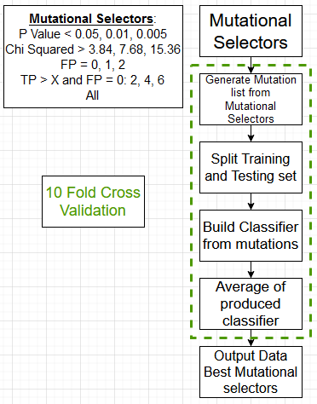
Pipeline

Slide 11
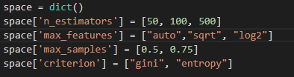
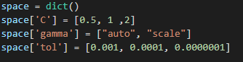
Parameter Space
Using Sklearn’s GridsearchCV a dictionary is made of parameters and all setting that we want to explore
The grid search then produces all possible combinations of parameters
The best parameters change based on the mutational selector
For example: RF, CHI > 3.86
500, auto, 0.5, gini
~90% accuracy
RF, p-value <= 0.005
50, auto, 0.5, entropy
~89% accuracy
Notes:
The top if RF
The bottom is SVM

Slide 12
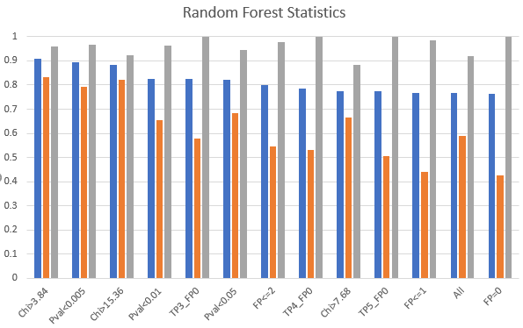
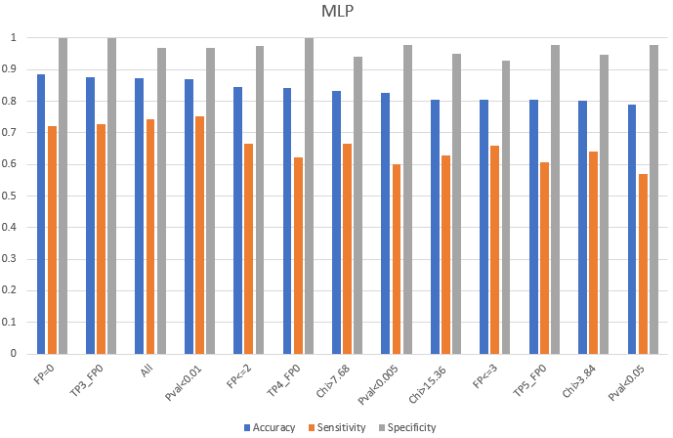
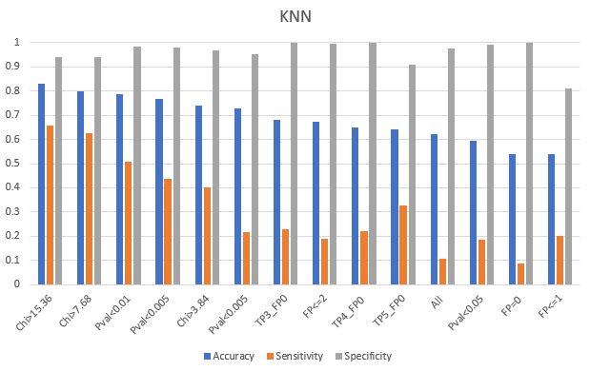
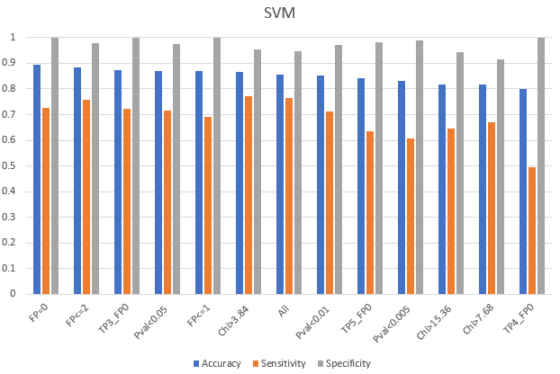
The mutations can predict CIMP status
Notes:
Compare to baseline
The random forest is chosen for its interpretability due to the gini index assigned to each mutation per classification
emphasize that RF was comparable to other methods, and had the highest accuracy
The other methods were used to provide a basis of comparison, e.g., based on accuracy, sensitivity, and specificity.

Slide 13
Results
Random forest is the highest performing supervised machine learning model for this data set, (~90% accuracy)
This result alone shows a connection between CIMP and the mutations that occur within the cancer cell.
The random forest is chosen for its interpretability due to the gini index assigned to each mutation per classification

Slide 14
Results
Separator Type | TP | FP | FN | TN | Accuracy | Sensitivity | Specificity | Included Muts
Chi>3.84 | 8.5 | 0.6 | 1.7 | 14.2 | 0.908 | 0.833333 | 0.959459 | 739
Pval<0.005 | 8.1 | 0.5 | 2.1 | 14.3 | 0.896 | 0.794118 | 0.966216 | 147
Chi>15.36 | 7.9 | 1.2 | 1.7 | 14.2 | 0.884 | 0.822917 | 0.922078 | 196
Pval<0.01 | 7.4 | 0.5 | 3.9 | 13.2 | 0.824 | 0.654867 | 0.963504 | 326
TP3_FP0 | 6 | 0 | 4.4 | 14.6 | 0.824 | 0.576923 | 1 | 159
Pval<0.05 | 8.2 | 0.7 | 3.8 | 12.3 | 0.82 | 0.683333 | 0.946154 | 845
FP<=2 | 5.6 | 0.3 | 4.7 | 14.4 | 0.8 | 0.543689 | 0.979592 | 5941
TP4_FP0 | 6.1 | 0 | 5.4 | 13.5 | 0.784 | 0.530435 | 1 | 57
Chi>7.68 | 8.1 | 1.5 | 4.1 | 11.3 | 0.776 | 0.663934 | 0.882813 | 383
TP5_FP0 | 5.7 | 0 | 5.6 | 13.7 | 0.776 | 0.504425 | 1 | 23
FP<=1 | 4.4 | 0.2 | 5.6 | 14.8 | 0.768 | 0.44 | 0.986667 | 2582
All | 6.7 | 1.1 | 4.7 | 12.5 | 0.768 | 0.587719 | 0.919118 | 8085
FP=0 | 4.4 | 0 | 5.9 | 14.7 | 0.764 | 0.427184 | 1 | 556

Slide 15
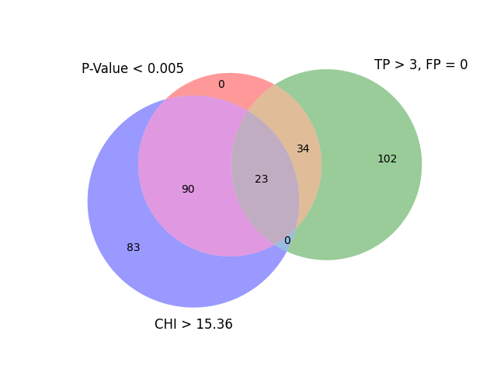
AFF1 | ABHD13
CDC25A | ARF5
DENND1C | BTBD11
HAS2 | CNTLN
KCNA4 | DDX3X
MAGI1 | ELOVL5
MESDC1 | GRHL3
PCDH9 | MAPK1
RSBN1L | PLXND1
SLC44A1 | PXDN
 | SIKE1
 | TCEAL1
 | ZMIZ1
Notes:
Genecards
The red genes indicate genes that have been found to have relationships with cancers

Slide 16
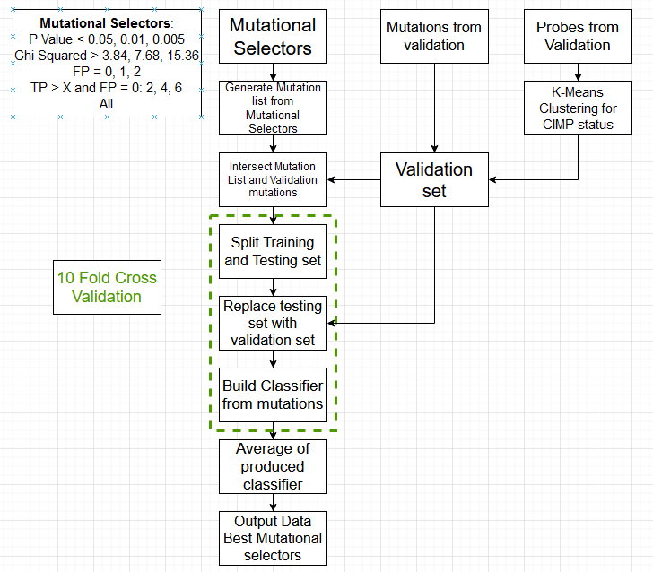
Validation
How do we prove that the classification model is not overfit to the TCGA data?
4 validation sets were used:
Uterine (Validation):
ICGC
Elnitski Cell line
Non-uterine (Pan-Cancer):
TCGA Colorectal Cancer
TCGA Gastric Cancer
If the TCGA classification model can accurately classify other datasets, this will help prove the model's functionality.
Notes:
mention the significance of the two different groups of test cases

Slide 17
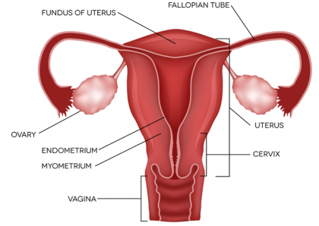
CIMP Classification for Unclassified Data
ICGC statistics
Samples: 38
CIMP+: 9
CIMP-: 21
CIMPi: 8
Mutation Overlap:28
Peak accuracy: 80.1%
Notes:
International cancer genome consortium

Slide 18
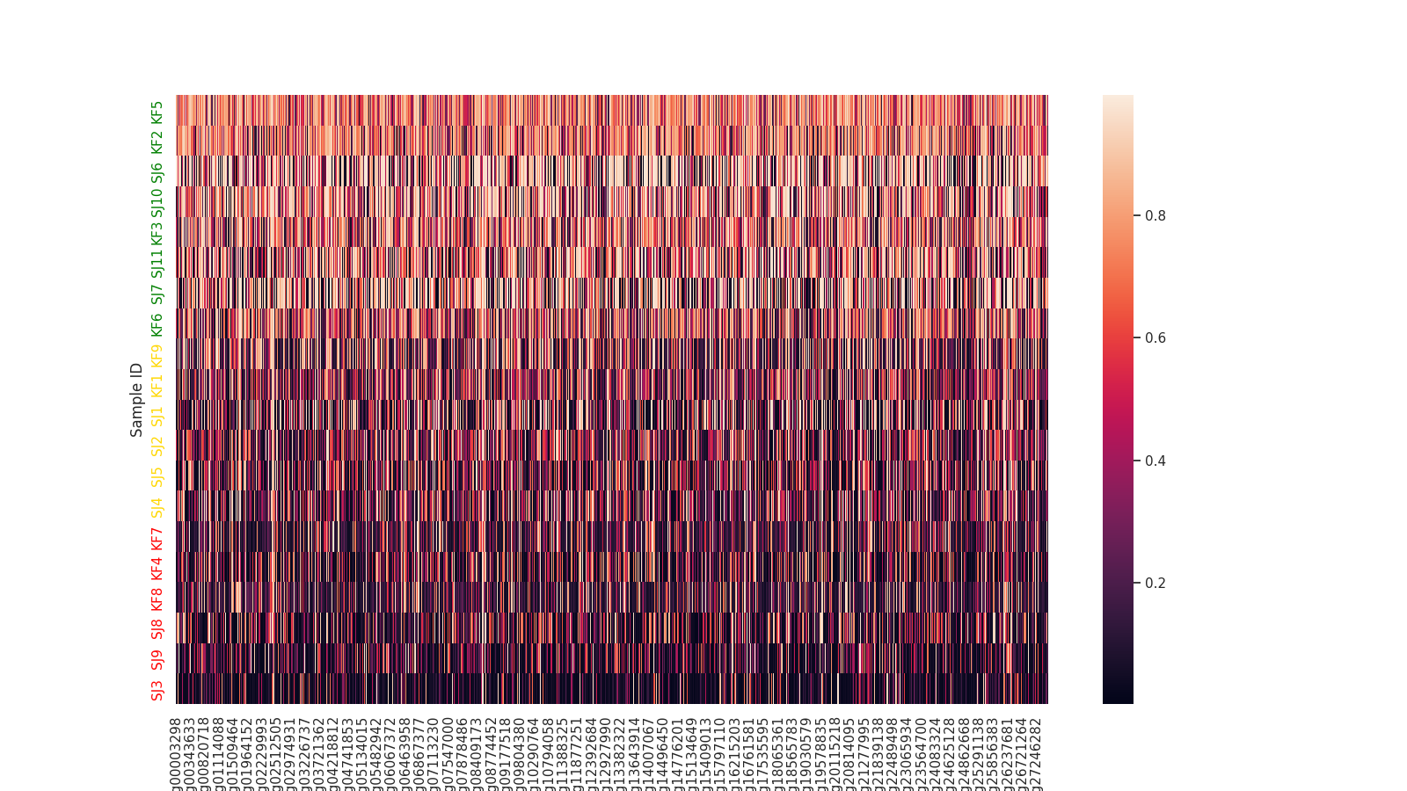
CIMP Classification for Unclassified Data
Elnitski Lab cell line statistics
Samples: 20
CIMP+: 8
CIMP-: 6
CIMPi: 6
Mutation Overlap: 345
Peak accuracy: 78.9%
Notes:
ICGC was uterine cancer
Cell line was 8 Ovarian and 12 Uterine
Elnitski Cell Lines
N = 20

Slide 19
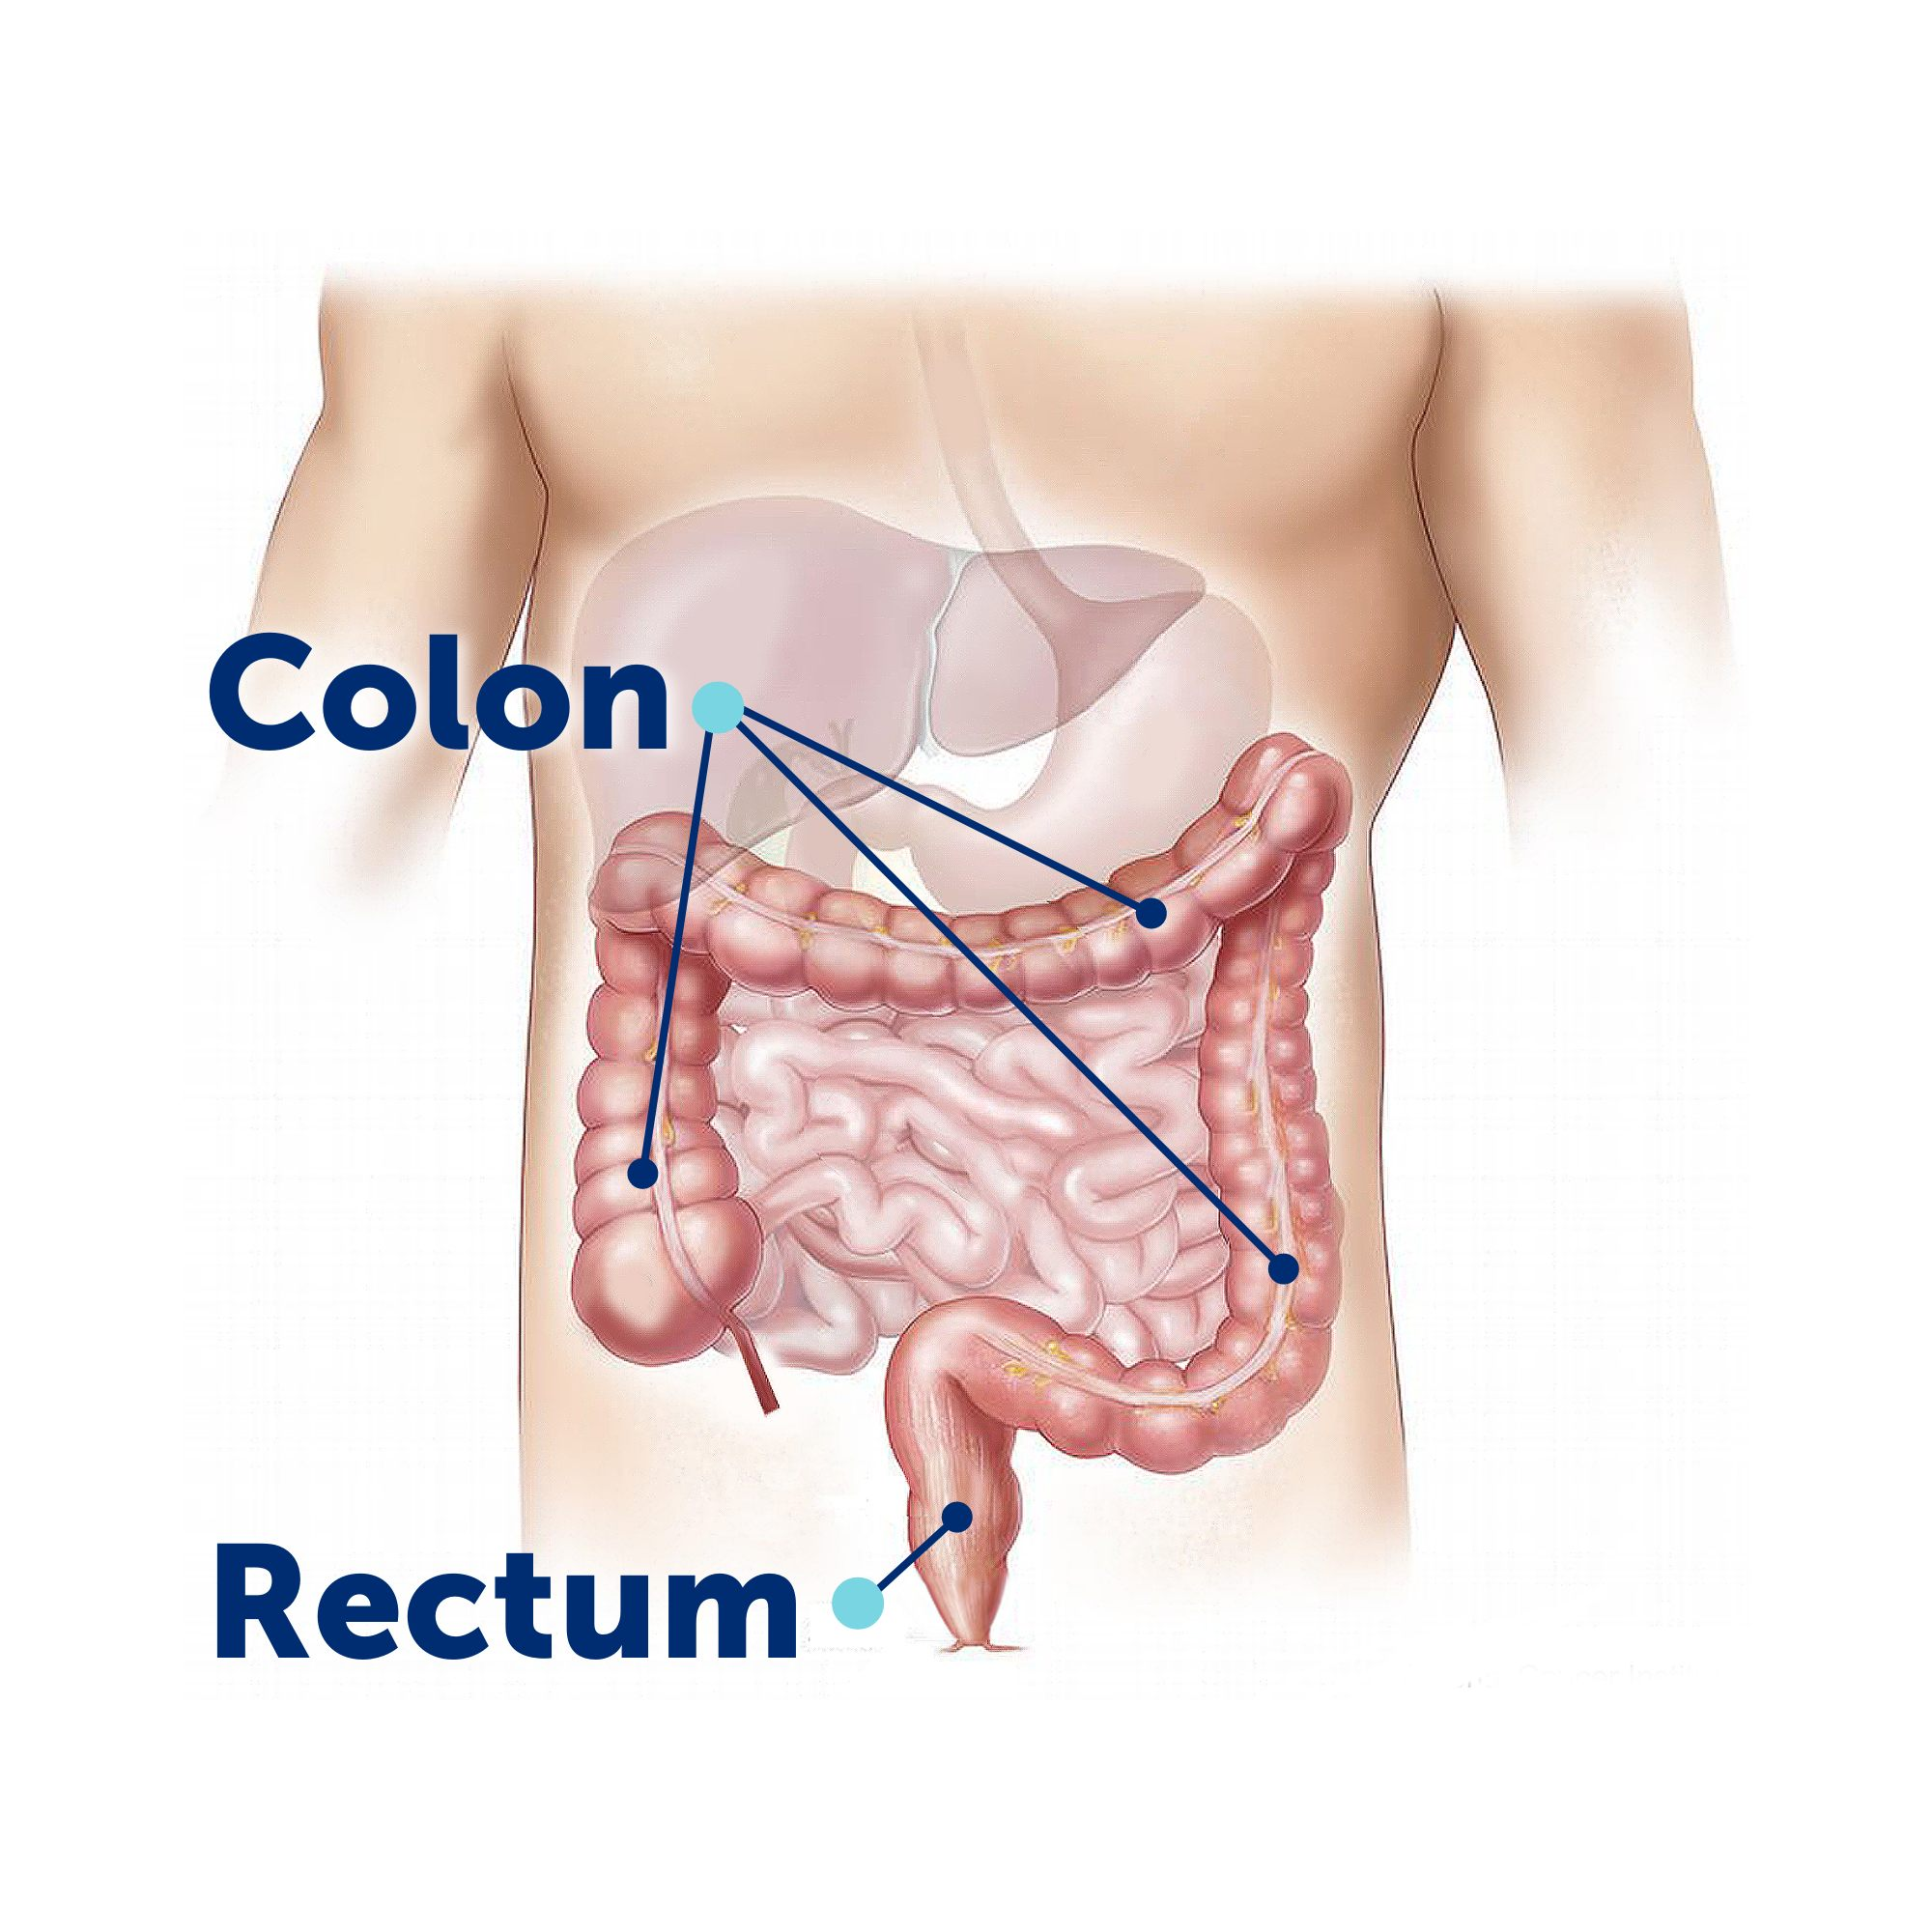
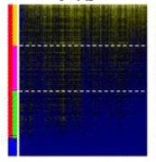
Validation TCGA Data (Sánchez-Vega et. al, 2015)
Two validation Sets were used form TCGA
Colorectal Cancer
Gastric Cancer
Colorectal Cancer Statistics
Samples: 360
CIMP+: 110
CIMP-: 120
CIMPi: 130
Mutation Overlap: 540
Peak accuracy: 81.0%
Notes:
These cancers are unique and having mutations that can classify across both cancers confirms that these mutations have a linkage to CIMP.

Slide 20
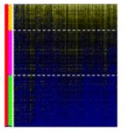
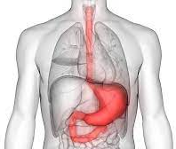
Validation TCGA Data (Sánchez-Vega et. al, 2015)
Gastric Cancer Statistics
Samples: 256
CIMP+: 56
CIMP-: 106
CIMPi: 94
Mutation Overlap: 215
Peak accuracy: 80.6%
Each cancer classifying at a high accuracy shows that the mutations have a strong linkage to the CIMP phenotype.
Gastric

Slide 21
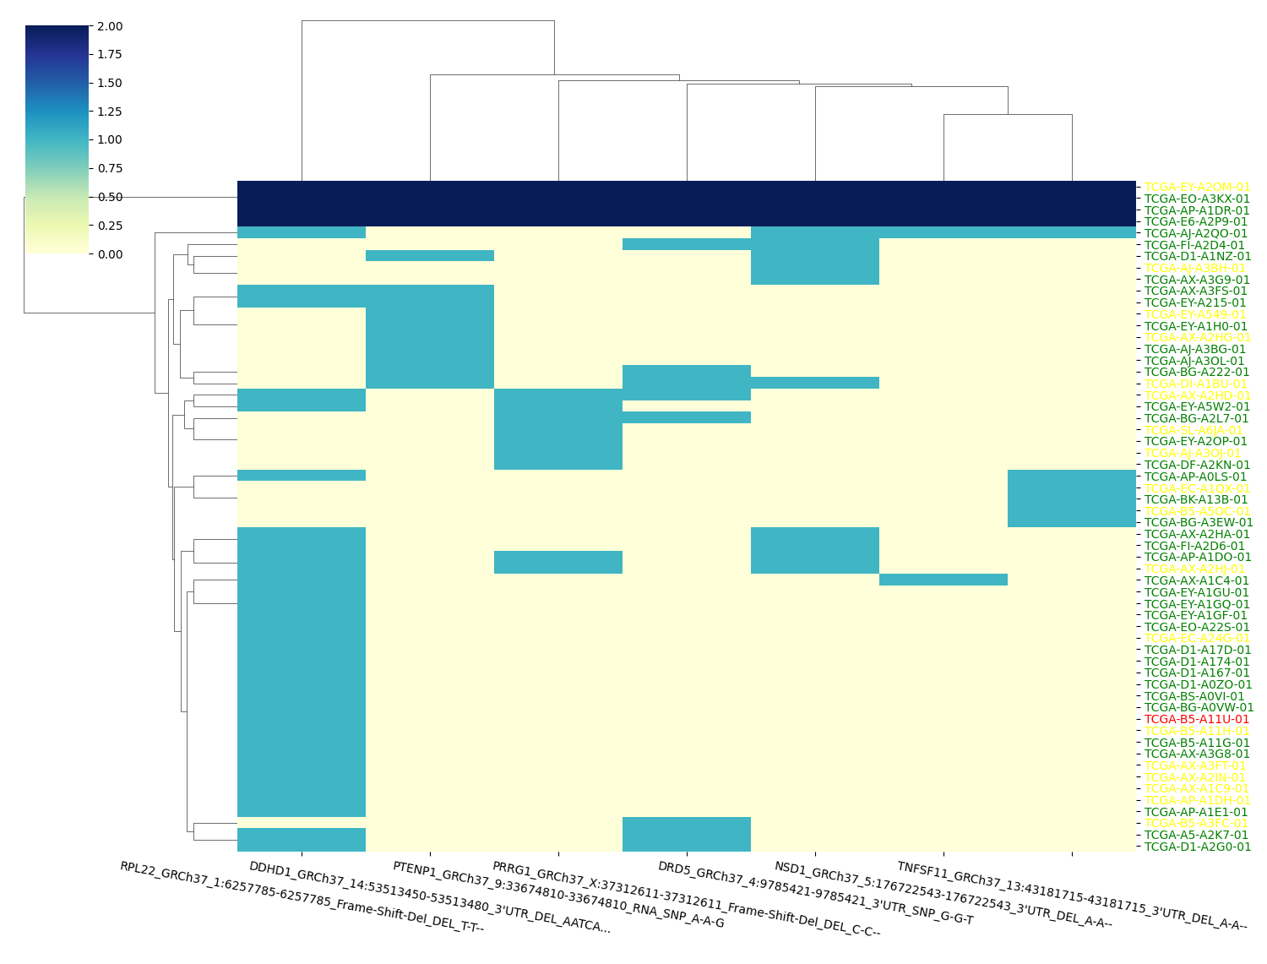
Mutations | P-Value
DRD5_GRCh37_4:9785421-9785421_3'UTR_SNP_G-G-T | 3.61E-05
PRRG1_GRCh37_X:37312611-37312611_Frame-Shift-Del_DEL_C-C--' | 0.005
PTENP1_GRCh37_9:33674810-33674810_RNA_SNP_A-A-G | 0.01
DDHD1_GRCh37_14:53513450-53513480_3'UTR_DEL_AATCAGTTT… | 8.59E-04
NSD1_GRCh37_5:176722543-176722543_3'UTR_DEL_A-A-- | 0.002
TNFSF11_GRCh37_13:43181715-43181715_3'UTR_DEL_A-A-- | 0.007
RPL22_GRCh37_1:6257785-6257785_Frame-Shift-Del_DEL_T-T- | 3.86E-09
Notes:
The graphic on the right shows 7 mutations and their corresponding p-value

Slide 22
Aim 2 – Find the relationships between the important mutations.
The seven mutations have at least 4 samples in common.
Using association rule mining, a collection of common and relevant mutations are discovered.
Notes:
Could the mutations work together to cause the phenotype? It’s a complex cause, possibly. There may be a lot of common passenger mutations.
• Point to Catherine’s work

Slide 23
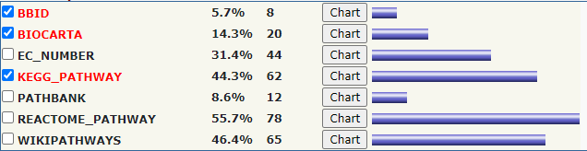
Aim 3 - Interpret the findings, biologically and medically.
This aim would consist of:
Identifying a collection of mutations and their effects in cancer.
Further research into the relationship between CIMP related mutations and their corresponding signaling pathways.
Notes:
involved in many cellular physiological events, cell-cycle control

Slide 24
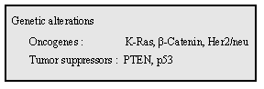
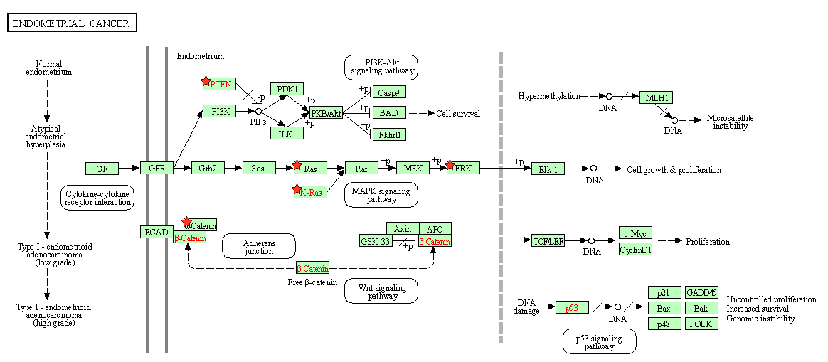
KEGG Pathways in Endometrial Carcinoma
Notes:
FOXO pathway is glucose matablilisum
involved in many cellular physiological events, cell-cycle control
An oncogene is a mutated gene that contributes to the development of a cancer

Slide 25
23 Classification Mutations (Cancer) (Genecards: The Human Gene Database)
Mutation | GeneCard | TP | FP | P-Value
HAS2 | HAS2 (Hyaluronan Synthase 2) is a Protein Coding gene. bladder, lung, ovarian and breast cancers | 9 | 0 | 9.68E-06
AFF1 | This gene encodes a member of the AF4/ lymphoid nuclear protein B-Lymphoblastic Leukemia and acute Leukemia. | 8 | 0 | 3.59E-05
RSBN1L | SBN1L (Round Spermatid Basic Protein 1 Like) is a Protein Coding gene Pilocytic Astrocytoma (Central Nervous system) | 6 | 0 | 0.000484
KCNA4 | KCNA4 (Potassium Voltage-Gated Channel Subfamily A Member 4) is a Protein Coding gene. Lung and prostate cancer | 7 | 0 | 0.000132
SLC44A1 | SLC44A1 (Solute Carrier Family 44 Member 1) is a Protein Coding gene Eye and Brain cancer | 6 | 0 | 0.000484
MAGI1 | This gene is a member of the membrane-associated guanylate kinase homologue (MAGUK) family Cervical Large cell Neuroendocrine carcinoma | 7 | 0 | 0.000132
MESDC1 | This gene encodes a protein that is regulated by micro-RNA MiR-574-3 Bladder cancer | 9 | 0 | 9.68E-06
PCDH9 | PCDH9 (Protocadherin 9) is a Protein Coding gene. Tumor suppressor Gene | 9 | 0 | 9.68E-06
DENND1C | The protein encoded by this gene functions as a guanine nucleotide exchange factor Renal Cancer | 6 | 0 | 0.000484
CDC25A | CDC25A is required for progression from G1 to the S phase of the cell cycle. frequently found in many cancers, and are often associated with high-grade tumors and poor prognosis | 6 | 0 | 0.000484

Slide 26
23 Classification Mutations (Non-Cancer) (Genecards: The Human Gene Database)
Mutation | GeneCard | TP | FP | P-Value
TCEAL1 | This gene encodes a member of the transcription elongation factor A (SII)-like (TCEAL) gene family. | 6 | 0 | 0.000484
ELOVL5 | This gene belongs to the ELO family. It is highly expressed in the adrenal gland and testis | 6 | 0 | 0.000484
ABHD13 | ABHD13 (Abhydrolase Domain Containing 13) is a Protein Coding gene. | 6 | 0 | 0.000484
BTBD11 | BTBD11 (BTB Domain Containing 11) is a Protein Coding gene. | 6 | 0 | 0.000484
ZMIZ1 | This gene encodes a member of the PIAS (protein inhibitor of activated STAT) family of proteins. | 6 | 0 | 0.000484
CNTLN | CNTLN (Centlein) is a Protein Coding gene. | 7 | 0 | 0.000132
MAPK1 | This gene encodes a member of the MAP kinase family. MAP kinases, also known as extracellular signal-regulated kinases (ERKs). | 6 | 0 | 0.000484
PLXND1 | PLXND1 (Plexin D1) is a Protein Coding gene. | 6 | 0 | 0.000484
GRHL3 | This gene encodes a member of the grainyhead family of transcription factors. | 6 | 0 | 0.000484
SIKE1 | SIKE interacts with IKK-epsilon (IKBKE; MIM 605048) and TBK1 (MIM 604834) and acts as a suppressor of TLR3 (MIM 603029) and virus-triggered interferon activation pathways | 7 | 0 | 0.000132
ARF5 | This gene is a member of the human ADP-ribosylation factor (ARF) gene family. | 6 | 0 | 0.000484
PXDN | This gene encodes a heme-containing peroxidase that is secreted into the extracellular matrix. | 6 | 0 | 0.000484
DDX3X | The protein encoded by this gene is a member of the large DEAD-box protein family, | 6 | 0 | 0.000484

Slide 27
Association Rule Mining Mutations (Genecards: The Human Gene Database)
Mutation | GeneCard | TP | FP | P-Value
DRD5 | This gene encodes the D5 subtype of the dopamine receptor. The D5 subtype is a G-protein coupled receptor which stimulates adenylyl cyclase. | 14 | 5 | 3.61E-05
PRRG1 | This gene encodes a vitamin K-dependent, gamma-carboxy-glutamic acid (Gla)-containing, single-pass transmembrane protein. | 8 | 4 | 0.005964
PTENP1 | PTENP1 represents a highly homologous processed pseudogene of PTEN (phosphatase and tensin homolog). Endometrial Cancer | 8 | 5 | 0.01182
DDHD1 | The protein encoded by this gene preferentially hydrolyzes phosphatidic acid. colon cancer | 10 | 4 | 0.000859
NSD1 | This gene encodes a protein containing a SET domain, 2 LXXLL motifs, 3 nuclear translocation signals (NLSs), 4 plant homeodomain (PHD) finger regions, and a proline-rich region. | 7 | 2 | 0.002771
TNFSF11 | This gene encodes a member of the tumor necrosis factor (TNF) cytokine family which is a ligand for osteoprotegerin and functions as a key factor for osteoclast differentiation and activation. Expressed in a large amount of cancer | 7 | 3 | 0.007054
RPL22 | RPL22 (Ribosomal Protein L22) is a Protein Coding gene. Colon and Uterine carcinoma | 27 | 10 | 3.86E-09

Slide 28
P-Value < 0.005 ∩ TP >3, FP=0 mutations
AMOT | ELAVL2 | LRRC57 | SLMAP
ARID1A | FAHD2A | MGAT3 | SRRT
ARL2BP | FOXJ3 | MMP16 | SRRT
B4GALNT4 | FOXP1 | PLEKHA3 | TP63
C11orf84 | HMBOX1 | RABL2B | TTC3
CD47 | HOXD10 | RTKN2 | UBE2G1
COL19A1 | ITGAV | SENP2 | VEGFA
CYTH1 | LCP2 | SEPHS1
DYNC2LI1 | LMAN1 | SHC4

Slide 29
P-Value < 0.005 ∩ CHI > 15.36 mutations
ACVR2A | BCOR | CSNK1G1 | DZIP1 | IRX3 | NCOA3 | PTENP1 | ST8SIA4 | UPF3A
AK2 | BTBD7 | CTCF | ESRP1 | JAK1 | NDST1 | RAB1B | SYDE2 | ZBTB20
ANKH | C3orf70 | CTNNA2 | FAM222A | KMT2C | NFIA | RBM12B | SYNE1 | ZBTB34
ANKRD13C | CAMSAP2 | DDHD1 | FAT1 | KRAS | NSD1 | RC3H1 | TCERG1 | ZFP91
API5 | CHD3 | DENND6A | FBXO48 | LMAN1 | POF1B | RNF2 | TFAP2B | ZNF217
ARID1A | CLVS1 | DOCK3 | FMR1 | MAF | POTEG | RNF43 | TMC7 | ZNF503
ASB7 | CNNM4 | DONSON | FOXP2 | MAP3K2 | POU4F2 | RPL22 | TMEM184B | ZNF609
BCAS3 | COBLL1 | DPF3 | G3BP1 | MSH3 | PPP2R1A | RYBP | TNRC18 | ZNF621
BCL11B | CPEB2 | DRD5 | GRIA2 | MUM1L1 | PRKCE | SENP1 | TRIM2 | ZNRF1
BCL7A | CSNK1A1 | DRD5 | INPPL1 | MYO1A | PTEN | SETD1B | TTK | ZXDB

Slide 30
In conclusion:
The results from the previous three aims show a strong connection between CIMP and mutations.
It was found that it is possible to correctly classify samples as CIMP with high accuracy of up to 90% on classification using only mutational data.
The classification models were then verified with unique datasets at ~80% accuracies.
We have found a distinct selection of mutations that can accurately separate the CIMP+ cancer samples from the CIMP- samples.
This breakthrough in technology could give us the ability to classify unknown samples, which could lead to improved diagnostics and therapeutics.
Next Steps:
Building classification models that would be able to study CIMP on a pan-cancer scale.
Analyze the most important mutations identified by the classification model by research into the relationships between CIMP related mutations and biological pathways.
Generate hypotheses for future experiments.

Slide 31
Reference List
Database, G. C. H. G. (n.d.). Genecards®: The Human Gene Database. GeneCards. Retrieved March 15, 2022, from https://www.genecards.org/
The cancer genome atlas program. National Cancer Institute. (n.d.). Retrieved March 15, 2022, from https://www.cancer.gov/about-nci/organization/ccg/research/structural-genomics/tcga
Sánchez-Vega, Francisco, et al. “Pan-Cancer Stratification of Solid HUMAN Epithelial Tumors and Cancer Cell Lines REVEALS Commonalities and Tissue-Specific Features of the CPG ISLAND METHYLATOR PHENOTYPE.” Epigenetics & Chromatin, vol. 8, no. 1, 2015, doi:10.1186/s13072-015-0007-7., https://pubmed.ncbi.nlm.nih.gov/25960768/
Miller, Brendan, et al. (2016) "The Emergence of Pan-Cancer CIMP and Its Elusive Interpretation." Biomolecules, vol. 6, no. 4, 2016, p. 45., doi:10.3390/biom6040045., https://pubmed.ncbi.nlm.nih.gov/27879658/
Kunitomi, Haruko, et al. “New Use of Microsatellite Instability Analysis in Endometrial Cancer.” Oncology Letters, vol. 14, no. 3, 20 July 2017, 10.3892/ol.2017.6640. Accessed 24 Nov. 2020., https://www.ncbi.nlm.nih.gov/pmc/articles/PMC5587995/

Slide 32
Acknowledgments
NIH Summer Internship Program
Dr. Elnitski, National Human Genome Institute
Dr. Welch
Catherine Baugher
Derek Petrosian
Julia Cygan
Trent Davis
Yingnan Zhang

